Slide 1

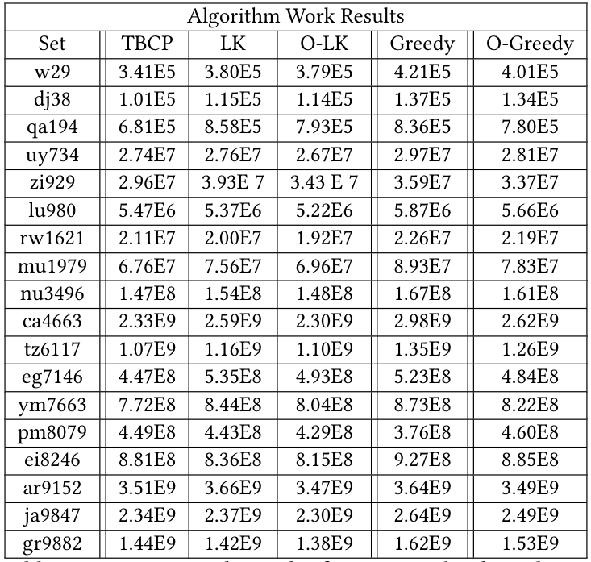
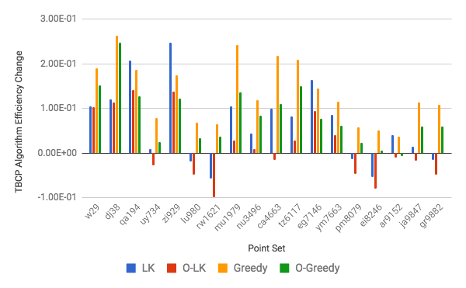
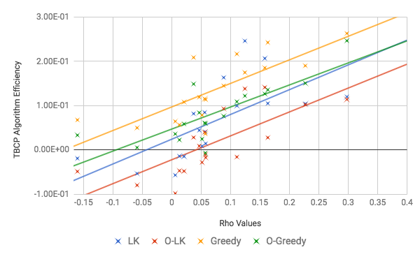
An Approximation Algorithm for a
Variation to the Traveling Salesman Problem
Tanner Bina, Joseph Mugisha, Alec Justice and Douglas Szajda
University of Richmond
Computer Science Department
No
Abstract
Clustering Algorithm
Figures
The Traveling Salesman Problem (TSP) has been studied extensively for years due to both its applications and complexity, leading to the development of many near optimal heuristic approaches. We present a new variation of this problem, the Tennis Ball Collector Problem (TBCP), in which travel costs increase based on tour position. This new problem has both real world applications and is interesting in the field of computational complexity as it increases the TSP's hardness by using a varying cost matrix. We present a novel approximation algorithm that deploys clustering, branch and bound, and the divide and conquer paradigm to quickly approximate large instances of the TBCP. To demonstrate the efficiency of this algorithm, we test it against other common heuristic methods to solve TSP variations. Our approximation algorithm not only provides good scaling and solutions, but also allows for further improvements as the study advances.
Use Hierarchical Clustering until CUT clusters have been defined and then return clusters.
Use centroid of clusters to determine distance between two clusters.
Use x, y, and z position of clusters to determine distance. Z is defined as average distance from other points.
Define value of VDIST of a cluster as the distance of the minimum spanning tree.
Define weight of centroid as size of cluster.
Reinput Subproblems
Algorithm Overview (Figure 1)
Work Results (Table 1)
Is the Point Set < CUT
Yes
Solve with B&B
Branch and Bound Algorithm
Used over the centroid of clusters to determine ordering.
Determine upper bound of inputted point set by a simple greedy heuristic followed by optimization.
Branch by creating tours from the last node forward to maximize lower bound.
Determine lower bound for each node with given constraining partial tour.
Find the MST of non constrained points.
Add minimal bounded MST edge using bound based on edge distance and weight of visited centroid.
Add all constraint edges. Calculated work of edges using variable weights instead of uniform weight.
Cluster into CUT Clusters
Find T_{Order} with B&B
Problem Statement
Return Solution
The Tennis Ball Collector Problem is a variation of the TSP. In the TSP, a salesman attempts to determine a route between a set of cities with a distance less than a given budget. This problem falls within a set of problems in computer science called NP-complete. This set is defined by the difficulty of obtaining solutions, as no polynomial time algorithms exist for these problems. The TSP can be further complicated by attempting to find the optimal route instead of simply one under the budget.
In the Tennis Ball Collector Problem, a person attempts to determine the route which minimizes the work done for collecting n tennis balls on a 2-D plane, given that collecting a tennis ball makes traveling to the next ball more costly. The work required to visit ball_{i} from ball_{j} where ball_{j} is the kth ball visited given that w_{initial} is the initial weight given to the problem is dist(ball_{j}-> ball_{i}) * (k + w_{initial}). This variation to the TSP is resistant to many heuristics used for the TSP as nearest neighbor an other similar algorithms would produce poor results.
Use T_{Order} to define subproblems
Combine Subproblems
Subtour Combination
Shows the work results of all tests run. Work is determined as states in the problem statement using the results tours from each algorithm.
Define subproblem for P_{i} as over all vertexes in cluster_{i} with start point equal to closest point in cluster_{i-1} and end point equal to closest point in cluster_{i+1}, w_{initial} = i.
Solve each subproblem recursively.
Combine order of point in sub problem not using start and end point in recombination to create T_{Final}.
Optimize T_{Final} using an Insert Optimization and a Switch-2 Optimization.
Return T_{Final}.
Optimize
Algorithm Effeciency Comparison (Figure 2)
Demonstrates the efficiency of our algorithm compared to the L-K heuristic, Optimized L-K heuristic (O-LK), greedy heuristic, and optimized greedy heuristic (O-Greedy).
Demonstrates greater efficiency on most points sets with a much higher maximum efficiency than minimum for all tests.
Algorithm Overview
Results
Our approximation algorithm is made of three key parts which allow it to use divide and conquer to effectively approximate large instances of the TBCP. The three parts of the algorithm are clustering points into subproblems, using a specialized branch and bound algorithm to order the subproblems, and then solving and combining the subproblems. In Figure 1, the layout of the algorithm can be seen in detail.
The algorithm’s structure is laid out in the following steps given that one iteration of it has inputs of a point set, a start and end point, and an initial weight :
Determine if the point set is less than a paramet CUT which states the maximum solvable size.
If it is, use a branch and bound algorithm to solve it and return the result.
Else continue execution,
Cluster the points into CUT different clusters.
Use a specialized branch and bound algorithm with each cluster treated as a point to find the optimal cluster tour, T_{Cluster}.
Use the order of T_{Cluster} to determine subproblem start and end points.
Solve subproblems in order their respective vertexes appear in T_{Cluster} with respective w_{initial}.
Combine subproblem tours and optimize resulting tour.
We tested our algorithm against the Lin-Kernighan heuristic for the TSP as well as a modified nearest neighbor algorithm (Table 1 & Figure 2).
Both are tested unoptimized as well as optimized with Insert Optimization and Switch-2 Optimization on 18 different point sets with 20 distributed start points.
While the runtime of our algorithm is yet to be analyzed, point sets ranging from 28 to 10,000 points were tested with CPU times for our algorithm ranging from 0-59 seconds.
On average our algorithm outperformed both other heurisics.
On 13 of the 18 sets our algorithm outperformed the L-K TSP algorithm, with an average outperformance of 6.44%. The greedy algorithm is outperformed on every set with an average of 13.5%. Results against optimized performed slightly worse with 1.66% and 8.30% respectively and only 9 out of 18 wins against the L-K and 17 against the Greedy algorithm.
Rho Correlation (Figure 3)
Rho Derivation
Demonstrates the strong correlation between high Rho point sets and increased comparative efficiency of our algorithm.
For point sets with Rho > .05, our algorithm outperforms almost all other comparison tests.
To determine the efficiency of our algorithm compared to other tested heuristics, we define a value Rho based on the variance of a point set.
Rho = (α * σ²_{Distance}/μ_{Distance} + β * σ²_{Closest}/μ_{Closest} - ɣ * MST_{Dist}/Range)/Range
Derived from analysis of the three factors we find α = .5, β = 6 and ɣ = 14.
Strong correlation between increasing algorithm efficiency and values for Rho (Figure 3).

